Slide 1


IRON ORE PRICE ANALYSIS
Name:Jayasri Kolli
Course Name: Professional Data Analytics
Project Name: Iron Ore Price Analysis
Mentor Name:Pallavi

Slide 2
Contents
Business Problem
Project Overview and Scope
CRISP-ML(Q)
Technical Stack
Project Architecture - Data Flow Diagram
Data Dictionary
System Requiremnets
Exploratory Data Analysis
Data Preprocessing
Data Visualization
Notes:
Change

Slide 3

Business Problem
The challenges lies in effectively analyzing the fluctuating prices of iron ore to inform strategic decision making for stakeholder in the mining manufacturing and energy sector.

Slide 4
Project Overview and Scope
Business Objective : Maximize profitability
Business Constraint : Minimize costs through informed decision making based on the analysis of iron ore prices.
Success Criteria:
Business Success Criteria: Achieving a 10 % increasing profit margins through optimized procurement and pricing strategies.
Economic Success Criteria : Generating a 20% increase in revenue from iron ore sales within the first year of implementation.

Slide 5
CRISP-ML(Q) Methodology
CRISP-ML(Q) stands for Cross-Industry Standard Process for Machine Learning with Quality assurance.
It is a process model that outlines the steps necessary for successful machine learning projects, ensuring high quality and reliability
By aligning our objectives with CRISP-ML(Q) methodology, we leverage SQL and Python for data preparation, apply advanced analysis techniques to identify optimal raw material combinations, and implement our findings to improve steel production efficiency and quality.

Slide 6
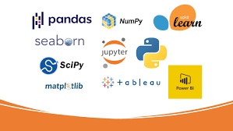

Technical stacks
Programming Languages:
1. Python: pandas, NumPy, SciPy, scikit-learn, matplotlib, seaborn.
Pandas: Data manipulation and analysis.
NumPy: Numerical data processing.
Matplotlib: Data visualization.
Seaborn: Statistical data visualization.
2. SQL: SQLAlchemy, pymysql.
EDA Techniques:
Statistical analysis and visualizations to identify correlations, trends, and outliers.
Data Storage and Management:
MySQL: Efficient data management and querying.
Data Analysis and Visualization:
Power BI: Interactive dashboards and reports.Displaying key performance indicators (KPI)

Slide 7
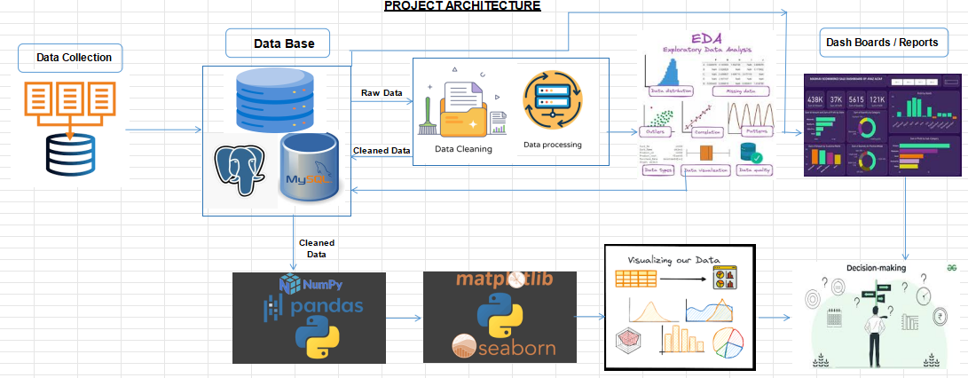
Project Architecture

Slide 8
Data Dictionary
Date : Date of the data entry, used to track daily prices and trends for iron ore and substitutes. Iron_Ore_Price: The price of iron ore per metric ton in INR. Fluctuates based on global demand, supply, and market conditions. Global_Demand: Total global demand for iron ore. Helps analyze supply-demand dynamics to forecast price trends. Global_Supply: Total global supply of iron ore. Important for understanding potential oversupply or shortages. Freight_Rate:The cost of shipping iron ore to various destinations, affecting the overall landed cost of the commodity. Stockpile:Iron ore stockpiles held by mines or at ports. Larger stockpiles can signal oversupply, influencing prices. Production_Volume:Daily iron ore production volume. Used to understand production capacity and potential bottlenecks. Production_Cost:The cost to produce one metric ton of iron ore, affecting profitability and pricing strategies. Ore_Grade:The quality/type of iron ore, such as Limonite, Siderite, Magnetite, etc. High-grade ores typically have higher prices. Mining_Location: The geographical location of the mine, which affects logistics, costs, and market access.

Slide 9
Data Dictionary
Exchange_Rate_USD: Exchange rate between USD and INR. Affects the international pricing of iron ore and global trade dynamics. Interest_Rate:The interest rate that influences the cost of capital for mining operations and expansions. Inflation_Rate:Inflation in key economies, impacting costs of production and market prices. GDP_Growth_Importer:The GDP growth rate of key iron ore importing countries (e.g., China). Higher growth often signals increased demand. Tariffs: Trade tariffs imposed on iron ore imports/exports. Tariffs can impact trade flows and pricing strategies. Steel_Production:Global steel production volume, a key driver of iron ore demand. High steel production typically increases iron ore demand. Carbon_Emissions:The amount of CO2 emissions generated per metric ton of iron ore produced. Important for sustainability and regulatory compliance. Aluminum_Price: The price of aluminum per metric ton, included as a substitute metal for iron ore. Copper_Price:The price of copper per metric ton, another substitute for iron ore in certain applications. Nickel_Price:The price of nickel per metric ton, used in high-strength steel alloys as a substitute for iron.

Slide 10

System requirements
Hardware:
Processor: Multi-core processor (e.g., Intel Core i5 or higher)
Memory (RAM): Minimum 8 GB (16 GB recommended)
Storage: SSD recommended for faster data access
Software:
Operating System: Windows, macOS, Linux
Python: Version 3.6+ with pandas, numpy, matplotlib, seaborn
Database: MySQL, PostgreSQL, SQL Server
IDE: Anaconda (Spyder, Jupyter Notebook), VS Code
Additional Tools:
Microsoft Excel for initial data exploration
Libraries: SQLAlchemy, pymysql for database interactions
Connectivity:
Internet access for updates and documentation

Slide 11
Exploratory Data Analysis [EDA]- SQL
Statistical Insights
Business Insights
The average global demand (1,943.92) is slightly lower than global supply (1,954.00). This suggests a balanced market.
High variance (77,606,561.38) and standard deviation (8,803.15) indicate significant fluctuations in iron ore prices, which could affect production costs and profit margins.
The kurtosis of 6,529.31 indicates that the distribution of iron ore prices is very peaked, suggesting that extreme values (outliers) may significantly influence pricing.
The negative kurtosis (-2.85) suggests a more uniform distribution of supply, indicating less volatility compared to demand.
The negative kurtosis values for aluminum, copper, and nickel suggest a more uniform distribution of prices, which could indicate stable market conditions.
The skewness values near 0.00 for many columns suggest that data distributions are relatively symmetrical, making statistical analyses more straightforward.
Iron Ore Price: The mean price is high, with significant price fluctuations as shown by high variance and standard deviation. The kurtosis suggests outliers are influencing prices.
Global Demand and Supply: Demand is slightly lower than supply, indicating market balance. Supply shows less volatility, while demand might need monitoring for changes.
Freight Rates: Average freight rates are significant, with high variability. These costs impact the overall profitability of iron ore pricing.
Stockpile Management: Stockpile levels are generally manageable but fluctuate, implying potential supply chain issues.
Production Volume and Costs: High production volumes with large variances suggest inefficiencies. Production costs are variable across operations.
Notes:
EDA is used for seeing what the data can tell us before the modeling task.
Change

Slide 12
Exploratory Data Analysis [EDA]-Python
Statistical Insights
Business Insights
Highly skewed distribution indicates many low prices with a few very high prices; indicates potential outliers.
Relatively symmetrical distribution; low skewness suggests stable demand.
Slightly negative skewness suggests a slight tendency toward lower values in the dataset.
Low skewness and high variance indicate variability in freight costs.
Relatively symmetrical with low variance; stable stock levels indicate effective inventory management.
Highly skewed to the right, indicating most production is at the lower end with some high-volume outliers.
Symmetrical distribution suggests consistent production costs; low variability.
High volatility indicates instability in the iron ore market, affecting production costs.
Stable demand supports planning for production and inventory management.
Balanced supply levels suggest a healthy supply chain.
High variability in freight rates could impact logistics costs.
Consistent stockpile levels indicate effective inventory management.
High variability in production can impact supply consistency.
Variability in interest rates could affect borrowing and investment decisions.
Consistent inflation levels support stable economic conditions.
Notes:
EDA is used for seeing what the data can tell us before the modeling task.
Change

Slide 13
Exploratory Data Analysis [EDA]-Power Bi Dash Board
Statistical Insights
Business Insights
Positive skewness indicates higher prices; extreme variance suggests potential for significant pricing risk.
Positive skewness indicates many lower prices with some high prices; high variance indicates potential risk.
Slightly positive skewness suggests higher prices; high variance indicates significant price fluctuations.
Near-zero skewness suggests stable emissions management; low variability is beneficial for compliance.
Symmetrical distribution indicates efficiency in production; stable steel production levels are advantageous.
Symmetrical distribution; predictable tariff levels support trade cost stability.
Nearly symmetrical with low skewness; stable growth reflects a healthy economic environment.
Iron ore prices average at 12.65K, with production volume at 84.58M tons, showing seasonal fluctuations. Prices peak in May and decline before rising again year-end, indicating supply-demand imbalances.
A negative balance (-6.79K) suggests oversupply, which may drive prices down.
Magnetite (229.95B) and Siderite (239.07B) are top revenue generators. Optimizing their production could enhance profitability.
Australia and India lead in production and environmental influence, likely to face scrutiny over sustainability.
Supply remains steady, while demand is lower, suggesting potential for strategic supply cuts to stabilize prices.
Supply remains steady, while demand is lower, suggesting potential for strategic supply cuts to stabilize prices.
Notes:
EDA is used for seeing what the data can tell us before the modeling task.
Change

Slide 14
Data Preprocessing
Handling Missing Values:
Applied KNN Imputer to fill missing values in numerical columns. Replaced missing values in categorical columns with 'Unknown'.
Handling Duplicates:
Detected and found no duplicate rows.
Outlier Treatment:
Applied IQR-based capping to handle outliers.
Variance Check:
No columns with zero or near-zero variance found.
One-Hot Encoding:
Encoded categorical columns using one-hot encoding.
Notes:
Keep observations

Slide 15
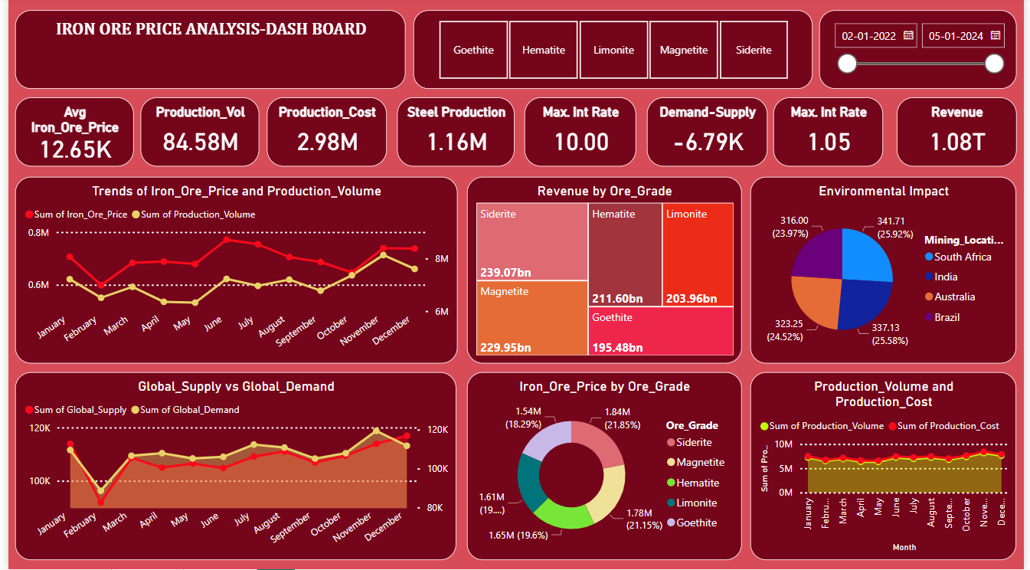
Data Visualization -Power Bi Dash Board
Notes:
Add graphical

Slide 16
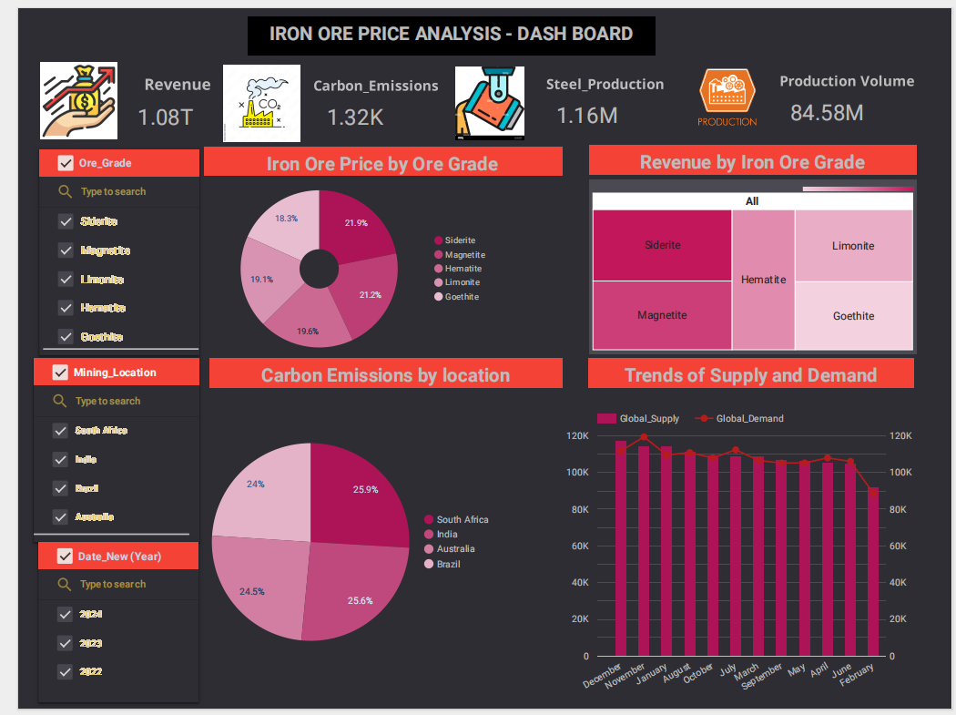
Data Visualization -Google Looker Studio Dash Board
Notes:
Add graphical

Slide 17


